Slide 1
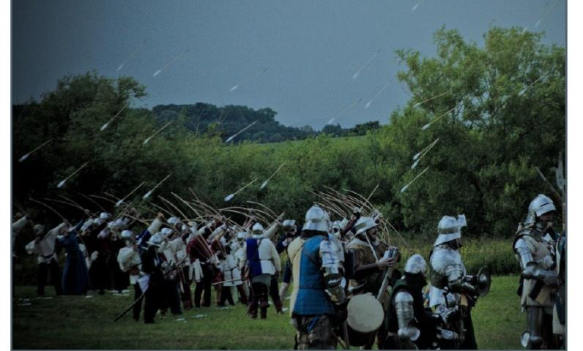
Volley
Volley : a burst of emission of many things or a large amount at once In Google IO’s speech.
Easy, Fast Networking for Android
Notes:
Volley is especially suitable for small data quantity but frequent communication scenario.

Slide 2
Volley Characteristics
Volley automatically schedule all network requests. It means that Volley will be taking care of all the network requests of your app.
Cache responses and memory management
Cancellation of request API
Request queuing and prioritization.
Provides powerful customization abilities
Small Metadata Operations but frequently
Notes:
Why volley is not suitable for large download or streaming operations?
Volley has in built feature where it caches the response during parsing. Therefore, it is not suitable for
Large download or streaming operations.

Slide 3
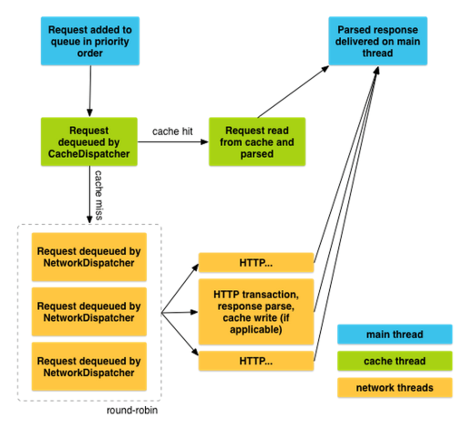
How it works
Notes:
Volley has pool of threads, when you add the request to the queue, the cache thread picks it up, if the request is serviced
from the cache, the cached response is parsed on the thread and parsed response is delivered to the main thread.
In case we got a miss and if the request cannot service by the cache thread, then it is picked up by the network thread.
The available network threads which runs in round robin pattern(轮询调度模式) takes the request from the queue and performs
the HTTP transaction，parse the responses on the worker thread then write the response to the cache, and posts the parsed
Response to the main thread for delivery.
We can request for response from any thread, but response are always delivered on the main thread.
RequestQueue -- thread safe class.

Slide 4
How To Get Started?
Creating New Project
compile ’com.android.volley:volley:1.0.0’
or compile project (‘:volley’)
or compile files (‘files/volley.jar’)
Internet permission
<uses-permission android:name=“android.permission.INTERNET”>
Creating Volley Singleton Class
VolleyPlus

Slide 5
Making a get/post request
public void requestDeviceList(){ final LoadingDialog dialog = new LoadingDialog(this); dialog.show(); final Request request = new DeviceListRequest(new BaseRequest.ResponseListener<DeviceListEntity>() { @Override public void onResponse(DeviceListEntity response) { dialog.dismiss(); if(response.isSuccess()){ mDevices.addAll(response.getDeviceList()); mDeviceAdapter.notifyDataSetChanged(); }else{ UiUtils.toBusinessError(MainActivity.this, response); } } @Override public void onErrorResponse(VolleyError error) { dialog.dismiss(); UiUtils.toError(MainActivity.this, error); } }).setTag(MainActivity.this); dialog.setOnCancelListener(new DialogInterface.OnCancelListener() { @Override public void onCancel(DialogInterface dialog) { request.cancel(); } }); VolleyPlus.getInstance().enqueue(request); }
Notes:
Request abstract class
Response<T> parseNetworkResponse(NetworkResponse response) worker thread
deliverResponse(T response) main thread

Slide 6
Prioritization
LOW
NORMAL
HIGH
IMMEDIATE Request.getPriority()
DEFAULT -- FIFO
Notes:
mCurrentQueue - using to cancel request
mWaitingQueue - waiting cache
mCacheQueue - cache
mNetworkQueue - network

Slide 7
Cache
Cache
DiskBaseCache LinkedHashMap – Lru key -value url – CacheHeader Using files to store response data.
How to use cache? Request setShouldCache(true)
Clear Cache
RequeueQueue.getCache().clear()/remove(key)
Notes:
Cache
ttl expired?
softTtl need refresh?

Slide 8
Retry Policy
interface RetryPolicy
class DefaultRetryPolicy time out ms max retry number
backoff multiplier
How to use
Request setRetryPolicy(RetryPolicy rp)

Slide 9
Making Image request
Loading image in NetworkImageView ImageLoader imageLoader = VolleyPlus.getInstance().getImageLoader();
imgNetworkView.setImageUrl(imgUrl, imageLoader);
Loading image in ImageView VolleyPlus.getInstance().loadImage(imageUrl, imageView);

Slide 10
Uploading a image
private void uploadImage(File imageFile){ final LoadingDialog dialog = new LoadingDialog(this, R.string.progress_upload); dialog.show(); final Request request = new ImageUploadRequest(imageFile.getName(), imageFile, new BaseRequest.ResponseListener<Entity>() { @Override public void onResponse(Entity response) { dialog.dismiss(); if(response.isSuccess()){ // }else{ UiUtils.toBusinessError(MainActivity.this, response); } } @Override public void onErrorResponse(VolleyError error) { dialog.dismiss(); UiUtils.toError(MainActivity.this, error); } }).setTag(MainActivity.this); dialog.setOnCancelListener(new DialogInterface.OnCancelListener() { @Override public void onCancel(DialogInterface dialog) { request.cancel(); } }); VolleyPlus.getInstance().enqueue(request); }

Slide 11
Cancelling requests
Cancel single request request.cancel();
Cancel multiple requests VolleyPlus.getInstance().cancel(tag);
Cancel all requests VolleyPlus.getInstance.cancelAll();
Notes:
The Request’s method setTag(Object tag) can set a tag to the request. This tag will be used to identify the request while cancelling it.
If the tag is the same for multiple requests, all the requests will be canceled. cancelAll() method is used to cancel any request.

Slide 12
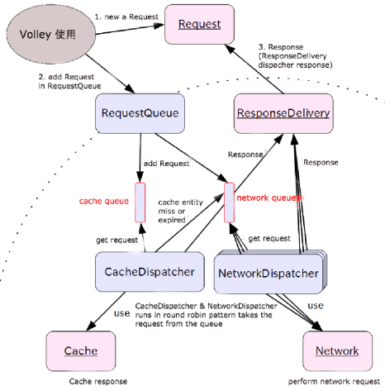
How it works

Slide 13
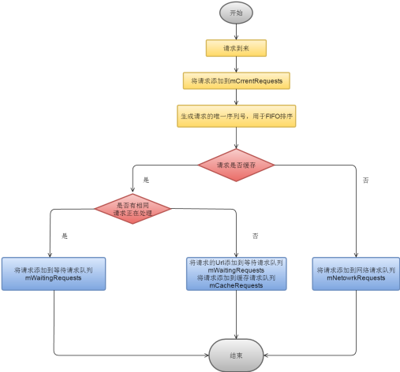
How RequestQueue works

Slide 14
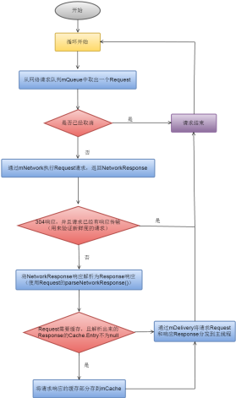
How NetworkDispatcher works

Slide 15
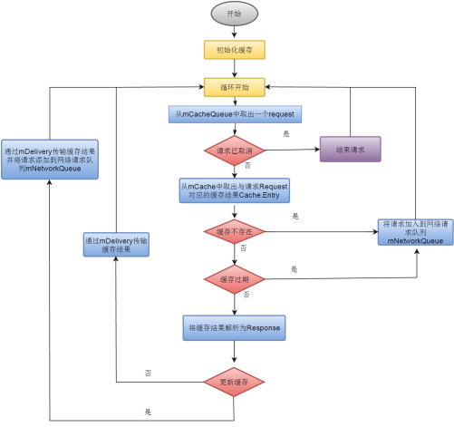
How CacheDispatcher works

Slide 16
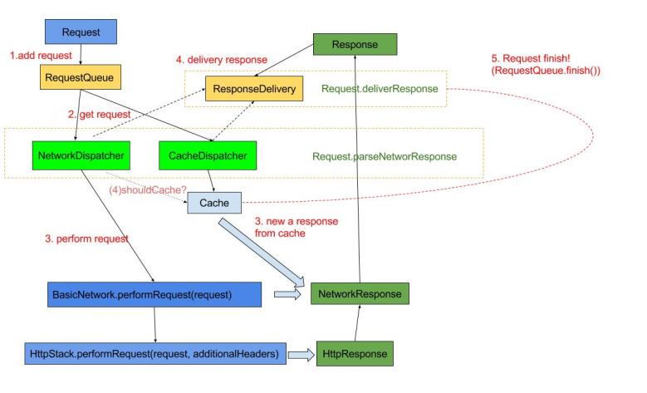
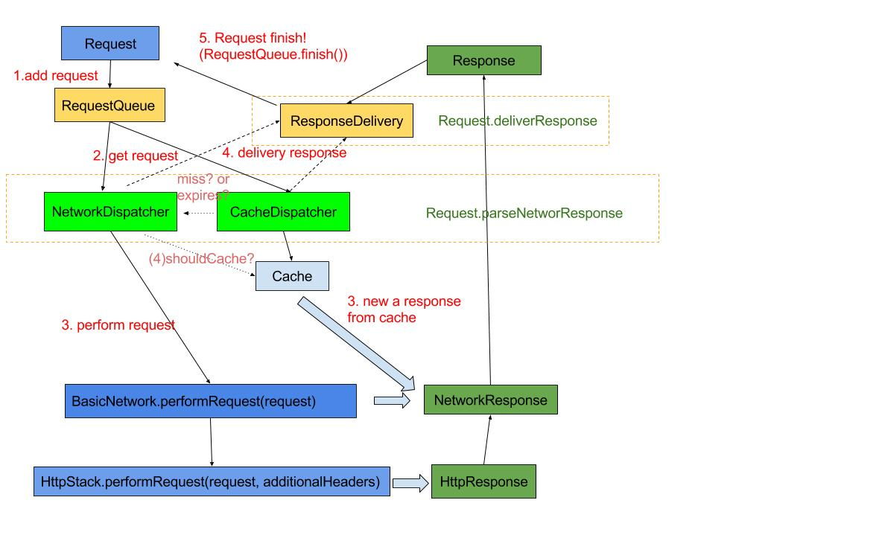
Response flow

Slide 17
